Slide 1
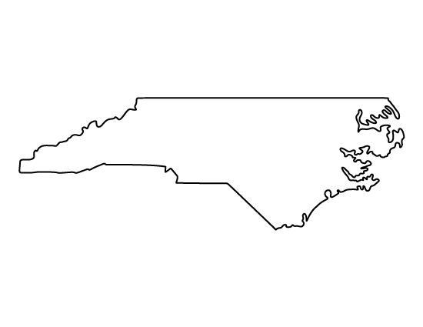
David Groce
Mobile 4
336-605-3333
groced@gcsnc.com
NORTH CAROLINA
&
U.S. HISTORY
2023-2024
UNITS
Unit 1: Exploration and Colonization
Unit 2: American Revolution
Unit 3: Constitutional Foundations
Unit 4: North Carolina and National Expansion
Unit 5: Civil War
Unit 6: Industrialization and Immigration
Unit 7: World War I and Roaring 20s
Unit 8: Great Depression and World War II
Unit 9: Post World War II and Civil Rights
Movement
Unit 10: Modern United States
CLASS OVERVIEW
North Carolina history covers information from Native American civilizations in the state pre-exploration to Modern USA. We will cover information in a variety of ways in class. Students will learn the material through individual, partner and group work assignments.
REMIND
Please join your classes remind group to receive class and school updates throughout the year.
Core 1 text (GroceNW1) to 81010
Core 2 text (GroceNW2) to 81010
Core 3 text (GroceNW3) to 81010
Core 4 text (GroceNW4) to 81010
CLASSROOM RULES
Be Kind
Be Prepared
Stay Focused
No cell phones or earbuds will be allowed in the classroom unless otherwise instructed
BEHAVIOR CONSEQUENCES
1st offense verbal warning
2nd phone call home
3rd minor referral and a phone call home
4th office referral/possible major referral
GRADING POLICY
Classwork/Homework 30%
Quizzes 30%
Tests 40%
There will be an assessment after each unit of study. These assessments will be in the format of tests, written assignments or projects.
We will take quizzes throughout the year, as well to help guide learning.
I do not typically assign homework; however, any assignments that are not completed during the provided time in class may need to be completed at home.
Per 8th grade policy, late work will have a ten- point deduction for each day that the assignment is late.
If you are absent, be sure to check Canvas when you return to school to complete any missed work.
SUPPLY LIST
Folder or section in a binder (a binder can be shared with other classes)
Loose leaf paper
Pens/Pencils
***Please try to keep your backpack as light as possible.
WISHLIST
Tissues are greatly needed and appreciated as donations throughout the school year.
I am looking forward to a wonderful school year with you!

